Slide 1
Information Warfare
Lecture 4

Slide 2
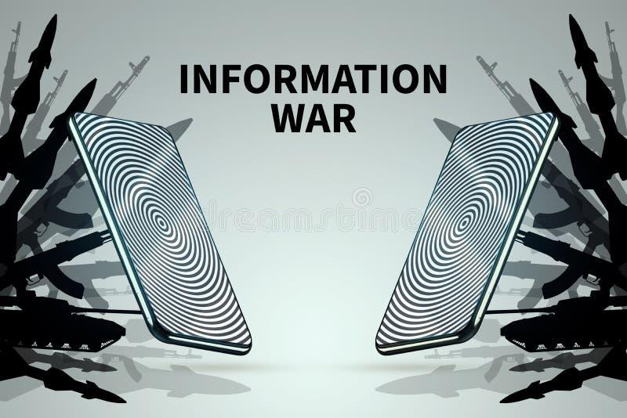
What is Information Warfare
Information warfare refers to the use of information and communication technologies to gain a strategic advantage in military, political, or economic conflicts. It involves the deliberate manipulation, exploitation, or disruption of information systems and communication networks to achieve specific objectives.
800 × 534

Slide 3
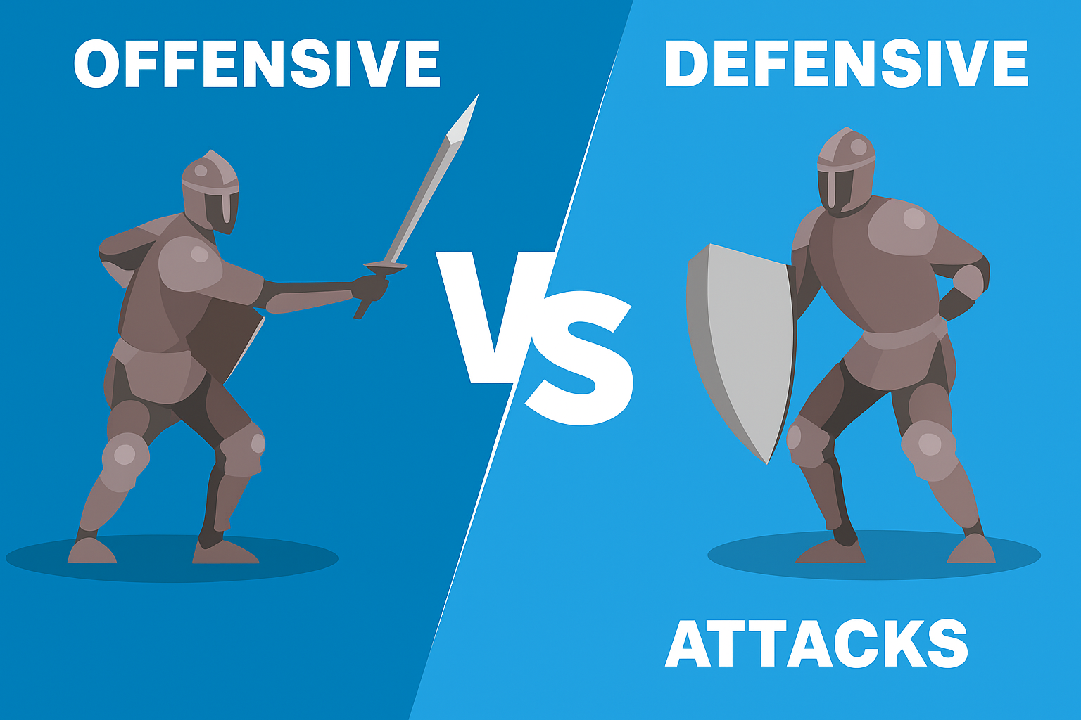
Information Warfare Strategy
Two distinct strategies of cyber operations and information security are:
Defensive information warfare and
Offensive information warfare

Slide 4
Defensive information warfare
Defensive information warfare focuses on protecting one's own digital assets, networks, and information from cyber threats and attacks.
The primary goal of defensive information warfare is to ensure the confidentiality, integrity, and availability of data and systems while safeguarding against unauthorized access, data breaches, and other cyber incidents
Defensive information warfare tactics:
Cybersecurity Practices
Incident Response
Encryption
Access Control
Security Awareness Training
Vulnerability Management
Security Monitoring and Analytics

Slide 5
Defensive information warfare
Cybersecurity Practices: Implementing robust cybersecurity practices, including firewalls, intrusion detection systems, antivirus software, and regular security updates to defend against common cyber threats.
Incident Response: Developing and practicing incident response plans to swiftly detect, contain, and mitigate cyber incidents when they occur.
Encryption: Using strong encryption methods to protect sensitive data, ensuring that even if it's intercepted, it remains unintelligible to unauthorized parties.
Access Control: Managing user access to networks and systems through authentication mechanisms, least privilege principles, and multi-factor authentication.

Slide 6
Defensive information warfare
Security Awareness Training: Educating employees and users about cybersecurity best practices, recognizing phishing attempts, and being vigilant about potential threats.
Vulnerability Management: Regularly scanning and patching systems for known vulnerabilities to prevent exploitation by malicious actors.
Security Monitoring and Analytics: Continuously monitoring network and system activity for signs of potential security breaches or anomalous behavior.

Slide 7
Offensive information Warfare
Offensive information warfare involves taking proactive actions to target and exploit the digital assets and infrastructure of adversaries.
The primary objective is to gain a strategic advantage, disrupt the adversary's operations, or extract sensitive information
Offensive information warfare tactics:
Cyber Espionage
Cyber Attacks
Denial of Service (DoS) Attack
Advanced Persistent Threats (APTs)
Disinformation and Propaganda
Data Manipulation
Hardware Tampering

Slide 8
Offensive information Warfare
Cyber Espionage: Using sophisticated hacking techniques to infiltrate an adversary's networks and steal sensitive or classified information.
Cyber Attacks: Launching targeted cyber attacks to disrupt or disable an adversary's critical infrastructure, communication systems, or other vital services.
Denial of Service (DoS) Attacks: DoS attacks prevent legitimate users from accessing a website by flooding it with fake requests and forcing the website to handle these requests. This type of attack can be used to disrupt critical operations and systems and block access to sensitive websites by civilians, military and security personnel, or research bodies.
Advanced Persistent Threats (APTs): Employing long-term and stealthy cyber campaigns to gain access to an adversary's systems and remain undetected for extended periods.

Slide 9
Offensive information Warfare
Disinformation and Propaganda: Using social media and online platforms to spread false or misleading information, influencing public opinion or sowing discord. Propaganda : Attempts to control the minds and thoughts of people living in or fighting for a target country. Propaganda can be used to expose embarrassing truths, spread lies to make people lose trust in their country, or side with their enemies.
Data Manipulation: Tampering with or altering data in an adversary's systems to undermine their operations or decision-making processes.
Hardware Tampering: Mass tampering with any computer hardware at the production level to surveil another state or country.

Slide 10
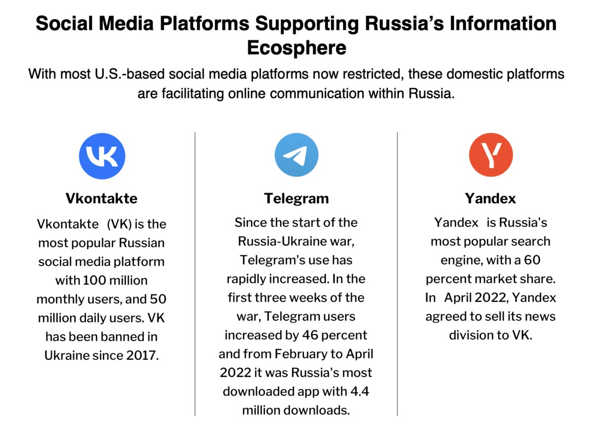
Information Warfare - Russia Ukraine

Slide 11
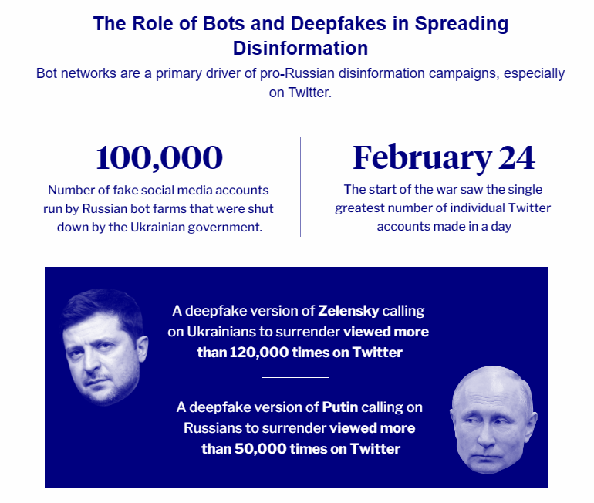
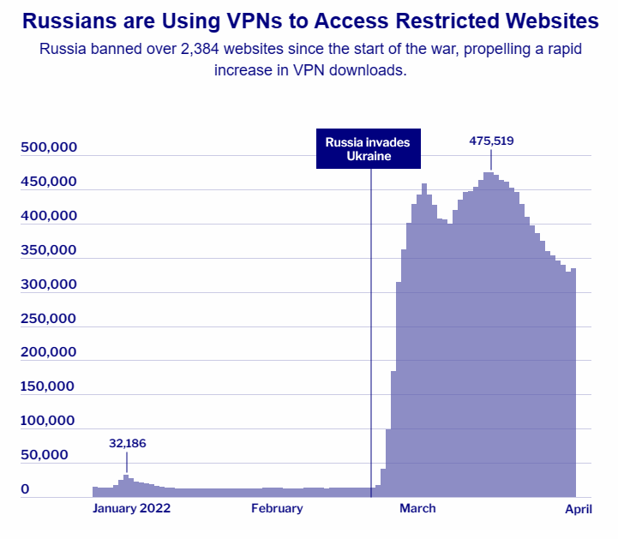
Information Warfare - Russia Ukraine

Slide 12
Thank You

